Slide 1
Salahaddin University-Erbil
Statistics Department
Fourth Stage
2023-2024
Multivariate Course
Chapter One : Review of Matrix Algebra
Asst. Prof. Dr. Hazhar T. A. Blbas
Statistics Department - MSc at UCF in 2014
Statistics Department – PhD at SUE in 2022
Founder and CEO of STAT Office for Statistical Data Analysis and Training
FB: SOSDAT

Slide 2
Chapter 1 Review of Matrix Algebra
The study of multivariate methods is greatly facilitated by the use of matrix algebra. This chapter presents a review of basic concepts of matrix algebra which are essential to both geometrical interpretations and algebraic explanations of subsequent multivariate statistical techniques.

Slide 3
Definition of Matrix
A rectangular array of numbers with, for instance, n rows and p columns is called a matrix of dimension n × p.
An n × m matrix, A, is a rectangular array of elements
n = # of columns
m = # of rows
dimensions = n × m

Slide 4
Definition of Vector
A vector, v, of dimension n is an n × 1 matrix rectangular array of elements
vectors will be column vectors (they may also be row vectors)
Diagonal matrix

Slide 5
Matrix addition
Example 1 : (Matrix addition)

Slide 6
Matrix Subtraction
Example 2: (Scalar multiplication and matrix subtraction)
Find 3A – B

Slide 7
Matrix Multiplication
Size of AB
where
Notes: (1) A+B = B+A, (2)

Slide 8
Example 3: (Find AB)
Sol:

Slide 9
Transpose of a Matrix
Properties of transposes:

Slide 10
Example 4: (Find the transpose of the following matrix)
(a)
(b)
(c)
Sol:
(a)
(b)
(c)

Slide 11
Symmetric Matrix
An n × n matrix, A, is said to be symmetric if
Properties

Slide 12
Trace and Determinant of a Matrix
Let A denote then n × n matrix
Then

Slide 13
also
where

Slide 14
Some properties

Slide 15
Orthogonal Matrix
A matrix is orthogonal
Example 5: Orthogonal Matrix
The following matrix P is orthogonal

Slide 16
Inverse Matrix
Properties of inverse matrices)
If A is an invertible matrix, k is a positive integer, and c is a scalar
not equal to zero, then

Slide 17
Zero Matrix
Zero matrx:
Properties of zero matrices:
Notes:
0_{m×n}: the additive identity for the set of all m×n matrices
–A: the additive inverse of A

Slide 18
Eigenvalues and Eigenvectors
Given a matrix, A, x is the eigenvector and λ is the corresponding eigenvalue if Ax = λx
A must be square and the determinant of A - λ I must be equal to zero
Ax - λx = 0 iff (A - λI) x = 0
Trivial solution is if x = 0
The nontrivial solution occurs when det(A - λI) = 0
Are eigenvectors unique?
If x is an eigenvector, then βx is also an eigenvector and λ is an eigenvalue
A(βx) = β(Ax) = β(λx) = λ(βx)

Slide 19
Example 6
Problem
Solution
Page 19

Slide 20
Problem
Solution
AX=0
$$\left[\begin{matrix}−4 & 4 \\ 2 & −2\end{matrix}\right]\left\lfloor \begin{matrix}X1 \\ X2\end{matrix}\right\rfloor =\left\lfloor \begin{matrix}0 \\ 0\end{matrix}\right\rfloor$$
-4X1 + 4X2 = 0
2X1 – 2X2 = 0

Slide 21
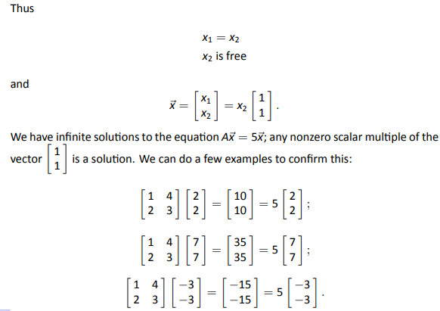
AX = λ X

