Slide 1
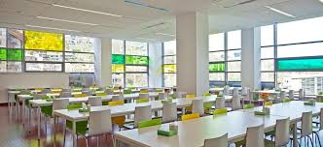
a cafeteria: it is a restaurant for students . you usually serve yourself.

Slide 2
A lecture hall: it is a place for lectures.

Slide 3
A lab: It is a place for experiments.

Slide 4
A degree: It is a certificate for university course

Slide 5
A graduate: it is a person with degree

Slide 6
A projector: It is a machine for showing slides, from power point

Slide 7
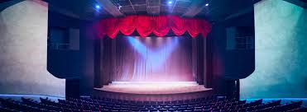
A theatre: it is a place for plays and sometimes music concert.

Slide 8
A sports center: It is a place for tennis and squash and football.

Slide 9
A field trip: It is work outside the university. You visit a place and do research

Slide 10
A librarian: It is a person in charge of a library.

